Slide 1
IPC-HERMES-9852 – Use Cases, Feature Set & Benefits
The Hermes Initiative | February 2020

Slide 2
Contents
Overview: Why a new Interface?
IPC-HERMES-9852 as SMEMA++
IPC-HERMES-9852 can do much more
Enabled by IPC-HERMES-9852 – Factory Multivendor Workflows
Relation IPC-HERMES-9852 to IPC-CFX-2591
Summary of Benefits & Members

Slide 3
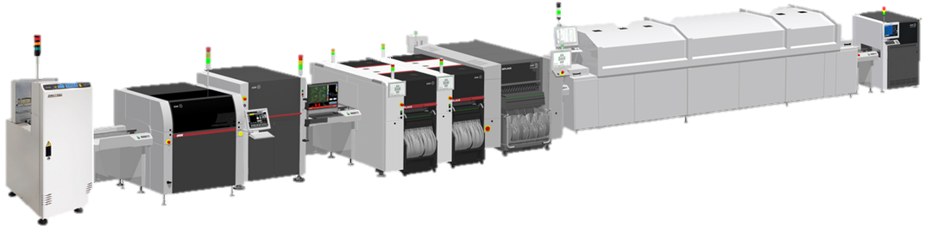


Why a new interface?
Old Technology meets the Challenge of today
Challenges
Highly automated / digitalized industry with more need of data
Full integration of the equipment
Need of direct machine-to-machine (M2M) communication
Need of simple integration into high-level systems (MES, IoT…)
Old M2M Standard
Based on “signals”, no data at all
Needs specific hardware
Is expensive
Restricts quick changes in line layout
Can be hardly adapted to future needs

Slide 4
Why a new Interface…?
High level line control system e.g. MES
The Old World
Complex and faulty where everything can be solved but integration is vendor specific, time consuming, expensive & hard to manage and, therefore, not customer oriented

Slide 5
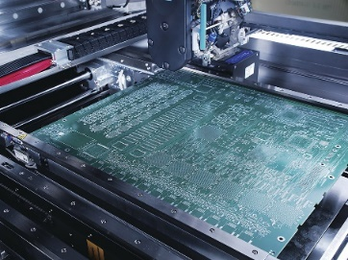
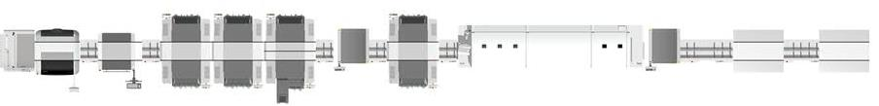

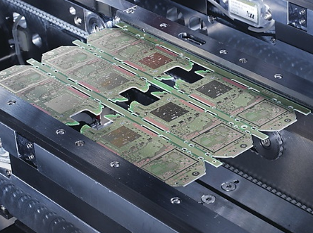
Why a new Interface…?
New Job Download = long Preparation Time
Example
Product B
Load
Print
SPI
Place
Trans
CPI
Shield
Trans
Oven
AOI
Repair
ICT
Repair
F-Test
Product A
Product B

Slide 6


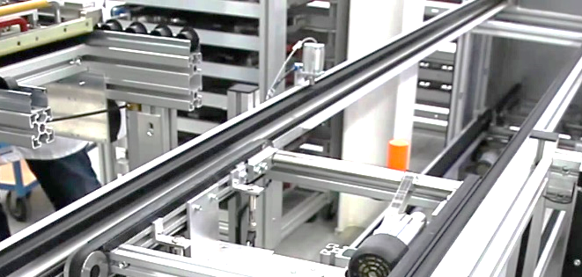
Why a new Interface…?
New Job Download = long Preparation Time
Example
Load
Print
SPI
Place
Trans
CPI
Shield
Trans
Oven
AOI
Repair
ICT
Repair
F-Test
Manual conveyor adjustment
Manual intervention to different equipment
Manual input of new parameters (error prone)

Slide 7
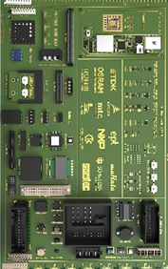

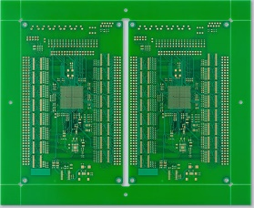
Why a new Interface…?
New Job Download = long Preparation Time
Example
Load
Print
SPI
Place
Trans
CPI
Shield
Trans
Oven
AOI
Repair
ICT
Repair
F-Test
Manual conveyor adjustment
Barcode reader adjustment

Slide 8






Why a new Interface…?
SMEMA cannot meet the Challenges of Smart Factories
Signal based
Protocol based & built to grow
Special needs
One standard interface with growing workflow coverage
No data exchange
Machines talk to machines with simple connectivity

Slide 9

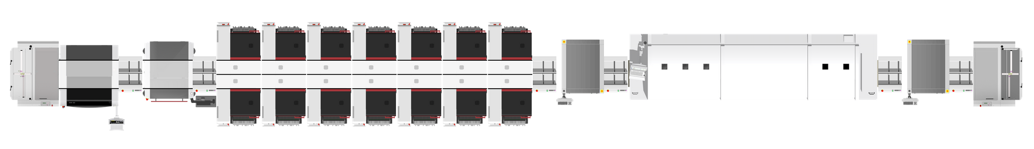
Full line machine-to-machine communication
Protocol based instead of “signal based”:
Easy to adjust and easy to expand for integrating further information
Standard components instead of “special needs”:
Based on TCP/IP, XML and ethernet, cables, plugs and interfaces are inexpensive and easily available
Integrated data management versus separation:
Consistent board and data assignment with consistent error handling and recovery

Slide 10
The Hermes Standard Initiative
Connectivity needs Cooperation
The Hermes Standard is a joint project of leading vendors of electronics assembly equipment
Active participation is open to all vendors of electronics assembly equipment
All members are equally important in
a fair and open decision-making process
There is no membership needed to implement and
sell products based on the standard
Working together for our customers
www.the-hermes-standard.info

Slide 11
Why a new Interface…?
Clear message from IPC:
IPC-HERMES-9852 represents THE next generation horizontal communication standard and replaces IPC-SMEMA-9851

Slide 12
Contents
Overview: Why a new Interface?
IPC-HERMES-9852 as SMEMA++
IPC-HERMES-9852 can do much more
Enabled by IPC-HERMES-9852 – Factory Multivendor Workflows
Relation IPC-HERMES-9852 to IPC-CFX-2591
Summary of Benefits & Members

Slide 13


Why IPC-HERMES-9852?
Automated Data Transfer
a
b
c
Different boards widths in one line, at the same time and without operator intervention
Protocol with board information
Load
Print
SPI
Place
Trans
CPI
Shield
Trans
Oven
AOI
Repair
ICT
Repair
F-Test
Automated conveyor adjustment
Manual conveyor adjustment
Barcode reader adjustment
High number of barcode readers

Slide 14


Why IPC-HERMES-9852?
Full Data Availability
Load
Print
SPI
Place
Trans
CPI
Shield
Trans
Oven
AOI
Repair
ICT
Repair
F-Test
Automated conveyor adjustment
Board identification (barcode / RFID…) needed only once per line
Barcode reader adjustment
High number of barcode readers
Speed optimization and buffer adjustment…

Slide 15
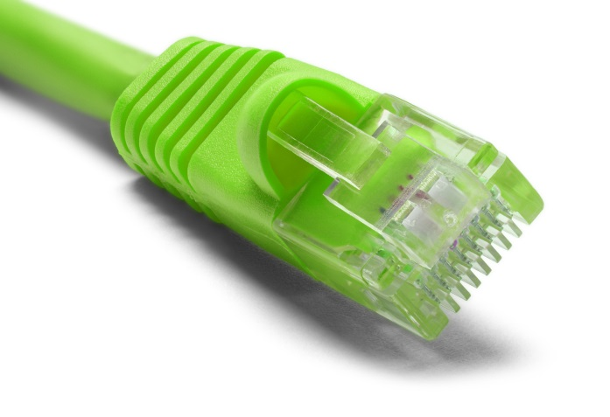
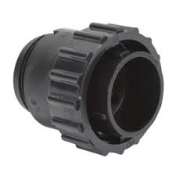

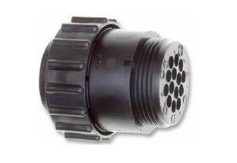
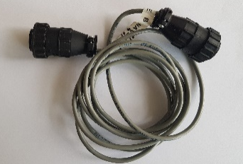
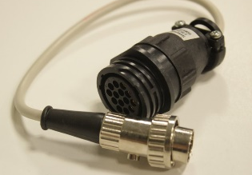
Why IPC-HERMES-9852?
Full Data Availability
Load
Print
SPI
Place
Trans
CPI
Shield
Trans
Oven
AOI
Repair
ICT
Repair
F-Test
Proven Ethernet. ONE Interface, ONE Standard!

Slide 16
Why IPC-HERMES-9852?
Protocol based
Protocol with board information
Upstream machine
Board Id
Failed Board
Product Type Id
Flipped Board
Top Barcode
Bottom Barcode
Width
Length
Thickness
Conveyor speed
Top clearance height
Bottom clearance height
Board weight
Downstream machine
Machine ready
Board available

Slide 17


Why IPC-HERMES-9852?
Advanced M2M Communication for Board Flow
The naive approach to data transfer
Increasing data transfer needs more data movement tools to support

Slide 18


Why IPC-HERMES-9852?
Advanced M2M Communication for Board Flow
ID
HERMES transfers keys (unique ID, barcode), not large amount of data
Allows efficient data exchange via an external data storage / database
No more big data storage in equipment needed

Slide 19

Why IPC-HERMES-9852?
Connectivity needs Cooperation
Non IPC-HERMES-9852 equipment?
SMEMA
SMEMA - HERMES - Adapter
(e.g. SICK Adapter, Scheid IT, 4IR.UK ...)
Non-HERMES equipment can be bridged by SMEMA-HERMES-Adapter

Slide 20
IPC-HERMES-9852 Special Scenarios
  What happens if you remove a board?
  Data will not be saved, if board is removed, it is no longer considered!
  The data package will be removed from the HERMES Interface (no longer valid data will not be transmitted)

Slide 21
IPC-HERMES-9852 Special Scenarios
  What happens if you remove a board and reinsert it again?
  Option 1: PCB data and tracking information can be requested from an external system (e.g. MES) based on scanned (or manually entered) barcode
High-level line control system e.g. MES
?

Slide 22
IPC-HERMES-9852 Special Scenarios
  What happens if you remove a board and reinsert it again?
  Option 1: PCB data and tracking information can be requested from an external system (e.g. MES) based on scanned (or manually entered) barcode
  Option 2: PCB data and tracking information can be requested from the upstream machine (QueryBoardInfo request) based on scanned barcode
  Option 3: New HERMES BoardId is created. Board information is related to new HERMES BoardId at the next barcode reader. External systems can merge all collected board information.
  Option 4: Station (e.g. repair station, placement station, …) prompts the user to confirm that the inserted board is the one that was removed
NEW
HERMES ID

Slide 23
Contents
Overview: Why a new Interface?
IPC-HERMES-9852 as SMEMA++
IPC-HERMES-9852 can do much more
Enabled by IPC-HERMES-9852 – Factory Multivendor Workflows
Relation IPC-HERMES-9852 to IPC-CFX-2591
Summary of Benefits & Members

Slide 24
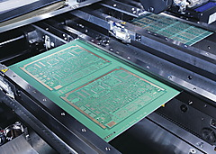
IPC-HERMES-9852
Handling of Ink Spots & Barcodes
  Whispering of ink spots, fiducials and barcodes across 3rd party equipment via HERMES board ID
  Fiducials
  No need for additional Software
  Save Costs
  Higher throughput without multiple Barcode reading via PCB Camera
  Ink Spots
  VENDOR A
  3rd Party Equipment
  VENDOR A
  Barcodes
Page 24

Slide 25
IPC-HERMES-9852
Single to Dual Conveyor
  IPC-HERMES-9852 supports Single to Dual Lane Conveyors and vice versa
  No additional SW needed to provide PCB data and support single to dual lane
  High PCB Data traceability along the line (reliable connectivity)
  Save costs
11/20/2020
Page 25

Slide 26


IPC-HERMES-9852
Configuration of the Line
  Central Configuration of IPC-HERMES-9852 for entire SMT Line
  Only one tool for configuration
  (no additional Engineering Station SW)
  Automated Connection Check (checkAlive)
  Engineering Station (e.g. SIPLACE Pro from ASM)
  IP Address
11/20/2020
Page 26
Notes:
checkAlive (test)

Slide 27
Contents
Overview: Why a new Interface?
IPC-HERMES-9852 as SMEMA++
IPC-HERMES-9852 can do much more
Enabled by IPC-HERMES-9852 – Factory Multivendor Workflows
Relation IPC-HERMES-9852 to IPC-CFX-2591
Summary of Benefits & Members

Slide 28


IPC-HERMES-9852
Barcode controlled Production: Automatic Job Download & Width Adjustment
  Automatic Conveyor Width adjustment based on PCB width information from IPC-HERMES-9852
  Automatic job download based on barcode information from IPC-HERMES-9852
  Board ID
  Board Id created by
  Failed board
  Product Type Id
  Flipped board
  Top barcode
  Bottom barcode
  Width
  … etc.
  No need for Barcode Reader
  No need for additional SW Solution
  Save Costs
  Improved process (Line prepared before job download)
  No operator intervention
  Central Job Manager or
  Program buffer in station itself
Query recipe /
program based
on received
Barcode
  Job
11/20/2020
Page 28
Notes:
-

Slide 29
IPC-HERMES-9852
Product Type ID controlled Production: Auto Job Download & Width Adjustment
  Automatic Conveyor Width adjustment based on PCB width information from IPC-HERMES-9852
  Automatic job download based on Product Type ID information from IPC-HERMES-9852
  Board ID
  Board Id created by
  Failed board
  Product Type Id
  Flipped board
  Top barcode
  Bottom barcode
  Width
  … etc.
  No need for Barcode Reader
  No need for additional SW Solution
  Save Costs
  Improved process (Line prepared before job download)
  No operator intervention
  Central Job Manager or
  Program buffer in station itself
Query recipe /
program based
on received
Barcode
  Job
11/20/2020
Page 29
Notes:
-

Slide 30


IPC-HERMES-9852
Process Interlocking without additional Barcode Scanners
  HERMES Message delivered upfront to next process machine in line before board handover
  Process equipment can query the MES based on this information without re-reading Barcodes
  No need for additional barcode reader beside a first point of reading at the beginning of the line
  No need for additional HW along the line
  Equipment independent process interlocking via virtual equipment (Man-in the-Middle) possible
  Process machine will directly connect to MES e.g. via CFX or other vertical interfaces
  Save Costs
  Board ID
  BoardIdcreated by
  Failed board
  ProductTypeId
  Flipped board
  Top barcode
  Bottom barcode
  Width
  …etc
  MES
11/20/2020
Page 30
Notes:
-

Slide 31
IPC-HERMES-9852 Vertical Channel
  Connecting Hermes data to the factory all the way from beginning to end-of-line
  Synchronization of data if board flow has been interrupted (board was taken out or reinserted)
  Whole line will be prepared based on board ID
  (i.e. barcode information) whispered from high-level SW
  In addition every equipment in line can send out BoardArrived / BoardDeparted messages in order to setup a very simple but powerful production monitoring solution
High-level line control system e.g. MES
Board Departed
Board Arrived
Board Departed
Board Departed
Board Departed
Board Departed
Board Arrived
Board Arrived
Board Arrived
Board Arrived

Slide 32

IPC-HERMES-9852
Multi-Line Connectivity via IPC-HERMES-9852 and Vertical Interfaces
  Vertical communication via e.g. CFX or HERMES vertical channel
or
HERMES
Vertical Channel
  Data is being whispered along the line via HERMES with seamless board-tracking
Query batch data based on Barcode
  No need for additional barcode reader beside a first point of identification at the beginning of the line
  No need for additional HW solutions
  Save Costs
  All data synchronized
  MES
Upload at end of line
Query batch data
Upload at end of line
Transfer to line A
Transfer to line B
Transfer out
11/20/2020
Page 32
Notes:
-

Slide 33
Contents
Overview: Why a new Interface?
IPC-HERMES-9852 as SMEMA++
IPC-HERMES-9852 can do much more
Enabled by IPC-HERMES-9852 – Factory Multivendor Workflows
Relation IPC-HERMES-9852 to IPC-CFX-2591
Summary of Benefits & Members

Slide 34


The Enabler of Industry 4.0 / Digital Factory Solutions
World-wide Industrial IoT communication standard for assembly manufacturing
Everyone has just one vertical interface for complete visibility, reducing costs and complexity
Machine vendors can further optimize machine operation based on wider knowledge
IT solutions work in a “plug and play” environment

Slide 35
Relation IPC-HERMES-9852 to IPC-CFX-2591
  IPC-HERMES-9852
    A 21st century SMEMA replacement using TCP/IP
    for point to point M-to-M connection
    Provides advanced, yet “light”, in-line messaging to support exchange of PCBs and data between machines
    Will drastically simplify the line management / supervision
    from a higher-level systems perspective
  IPC-CFX-2591 or any other vertical channel
    Provides “vertical” machine messaging
    Provides horizontal machine-to-machine messages
      For Industry 4.0
      Not for SMEMA or board handling & board ID tracking

Slide 36
Contents
Overview: Why a new Interface?
IPC-HERMES-9852 as SMEMA++
IPC-HERMES-9852 can do much more
Enabled by IPC-HERMES-9852 – Factory Multivendor Workflows
Relation IPC-HERMES-9852 to IPC-CFX-2591
Summary of Benefits & Members

Slide 37


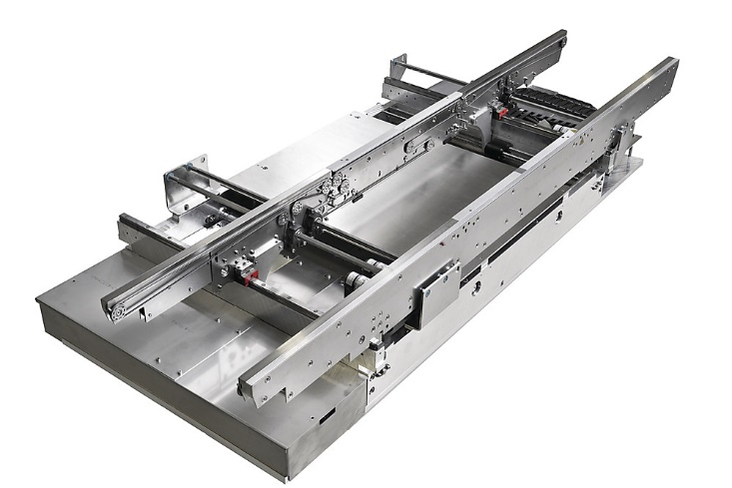
Customer Benefits
  Provides PCB Unique ID tracking along the SMT Line
  stable PCB - data connection
  Saves barcode readers
  Provides barcode and / or Product Type Id to host systems (automatic recipe / program download)
  Provides PCB width to host systems
  (automatic conveyor width adjustment)
  Whisper inks spots, barcodes and fiducials
  across 3rd party equipment
  Supports single to dual lane conveyors
  Station-based traceability instead of line-based traceability
  without re-reading of Barcodes
  Enables Multi-Vendor factory workflows
  (i.e. Interlocking, Product Changes via BC or Product Type ID)
  Job
  Barcode
UID
  automatic

Slide 38
The Hermes Standard Initiative
A broad foundation across the entire industry assures global acceptance
Current 60 members of the initiative as per November 2020
4IR.UK BRITISH SYSTEMS | CTI | GKG | JOT Automation | NUTEK | SEHO | TRI
6TL Engineering | CTS | GÖPEL | KEYSIGHT | OMRON | SEICA | UIC
ACHAT5 | CyberOptics | HANWHA | KIC | OSAI | Shenzhen HB | VISCOM
allSMT | Digital Test | HAYAWIN | KOH YOUNG | PARMI | SICK | ViTrox
ASM | ECD | HELLER | kolb Cleaning Technologies | PEMTRON | SMT | YJ LINK
ASYS | ERSA | HOLLY | KULICKE & SOFFA | REHM | SolderStar | YXLON
BESI | EUNIL | ILJIN | MAGIC RAY | REJOINT | SONIC
Bright Machines | eXelsius | IPTE | MIRTEC | RG Elektrotechnik | SPEA
BTU | FENIX | ITW EAE | MYCRONIC | SAKI | SYNEO
CKD | FLEXLINK | JAPAN UNIX | Nordson ASYMTEK | Scheid IT | SYSTECH
… and counting …
Another 8+ companies already agreed to join in a next meeting
Existing members
To join

Slide 39
The Hermes Standard:
Seamless Communication enables Industry 4.0
www.the-hermes-standard.info

